Slide 1










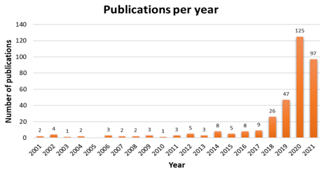






Micromobility Adoption: The Key to Sustainability and Active Transportation In British Columbia
Author: Rufaro Mundangepfupfu Instructors: Dr. Zubair Raja & Dr. Afia Raja
Introduction
Objective
Micromobility is a term referring to lightweight, compact vehicles that are driven personally by road users at speed lower than 30km/h. (Olabi, et al., 2023).
The term is generally used to describe systems that incorporate shared mobility services i.e., the provision of bicycles, e-bikes, and e-scooters for short-term rentals.
With the goal of creating a framework specific to British Columbia, for the introduction and adoption of micromobility systems in urban cities, we are exploring the following questions:
  How can the adoption of micromobility impact sustainable development goals in Canadian urban centres?
  What are the regulatory challenges and successes experienced by different Canadian municipalities in managing micromobility?
(Marques & Coelho, 2022)
Following the launch of shared e-scooters in California in 2017 by operators Lime and Bird, and their rapid growth, the number of micromobility publications saw a massive increase.

