Slide 1


SHAPING TOMORROW’S CITIES: THE SUSTAINABLE POTENTIAL OF MICROMOBILITY
Rufaro Mundangepfupfu
Thompson Rivers University

Slide 2
OVERVIEW
  1- Introduction
  5- Transit Integration
  2- Research Method
  6- Smart City Linkage
  3- Key Drivers
  7- UNSDG Contribution
  4- Barriers & Challenges
  8- Recommendations

Slide 3
INTRODUCTION
  Sustainable urban mobility solutions are growing in importance across Canada.
  The Transportation Association of Canada (TAC)’s project studying shared micromobility in Canadian communities was the quickest funded project to date in it’s history.
  This study analyzes the thoughts and perceptions of the individuals within Canadian University towns.
  The aim of this presentation is to examine the potential of micromobility within these towns, identify the key drivers & barriers to adoption, and to discuss the integration of smart city frameworks and micromobility.
Notes:
The growing importance of sustainable urban mobility solutions is evident in the strong interest and need expressed by municipalities across Canada for guidance and expertise on topics like shared micromobility.
The project studying shared micromobility in Canadian communities was the quickest funded project to date in the history of the Transportation Association of Canada, signaling a significant demand for solutions in this area.
Municipalities are increasingly looking for ways to reduce reliance on cars, promote more sustainable modes of transportation, and achieve lower carbon emissions as part of their broader policy mandates and transportation master plans.

Slide 4

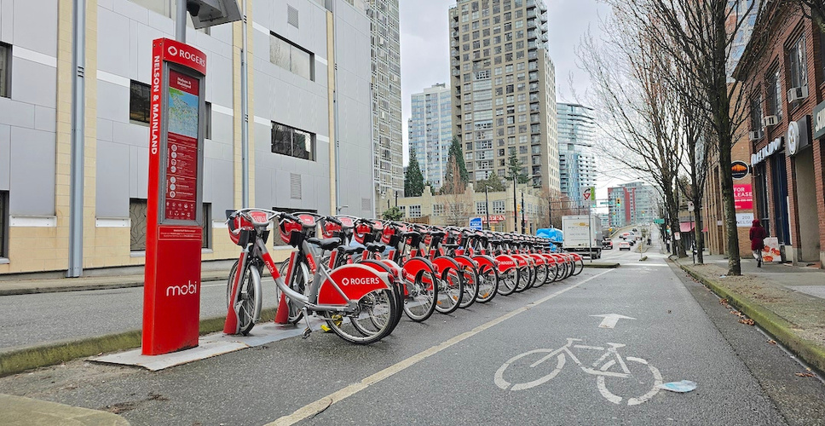
DEFINING MICROMOBILITY:
Micromobility refers to small, lightweight vehicles intended for single person use, typically over short distances. These include, bicycles, e-bikes, scooters, e-scooters, segways, mopeds, hoverboards etc. Shared micromobility however, typically refers to bike share and e-scooters. The shared micromobility scene is made up of various models. Docked bikes, Dockless Bikes and E-scooters.
Notes:
Dockless bikes: These are bicycles that do not require parking at a specific docking station. Users can typically locate and unlock them using a mobile app and can park them within designated areas at the end of their ride. Kelowna initially had a program with dockless pedal bikes in 2018.
Docked bikes: These are bicycles that must be picked up from and returned to designated docking stations. Examples of cities with docked bike share programs mentioned include Montreal (Bixie), Toronto (Bike Share Toronto), Quebec City (Aello), and Vancouver (Mobi). These systems often have physical infrastructure for parking and sometimes recharging.
E-scooters: These are stand-up electric scooters that users can rent for short trips. They can be dockless or, as in the case of Vancouver's new program, potentially utilize docking infrastructure. The use of e-scooters is subject to municipal bylaws and pilot programs in some provinces, like the 5-year pilot in Ontario.
Alta Planning + Design Canada, the group tasked by the Transportation Association of Canada (TAC) to analyse the Canadian shared micromobility landscape, noted an increase of programs from about 30 in 2023 to 42 in September 2024, with this number only continuing to grow. The findings of this study are now available under the name “Shared Micromobility Services in Canadian Communities”.

Slide 5
RESEARCH METHOD
Surveys
Expert Interviews
Literature Review
Surveys were designed for each of the target study areas to gather the the local perceptions about micromobility and their city’s adoption of it.
Interview were conducted with Canadian micromobility researchers, micromobility program operators, city planning officials, the Ministry of Transportation & Infrastructure, & the TAC.
Publications from the last 5 years on micromobility, sustainable transportation, smart city frameworks, and active transportation were reviewed in order to plan the survey creation and prepare interview questions.
Notes:
This study was conducted using a mixed method approach which included surveys for each study area and expert interviews with the TAC, Alta Planning + Design, the Kelowna Micromobility manager as well as the Operating manager at Lime Kelowna. A literature review of the last five years and case analyses of cities like Vancouver & Kelowna were also conducted to create a holistic picture of the issue of micromobility.

Slide 6
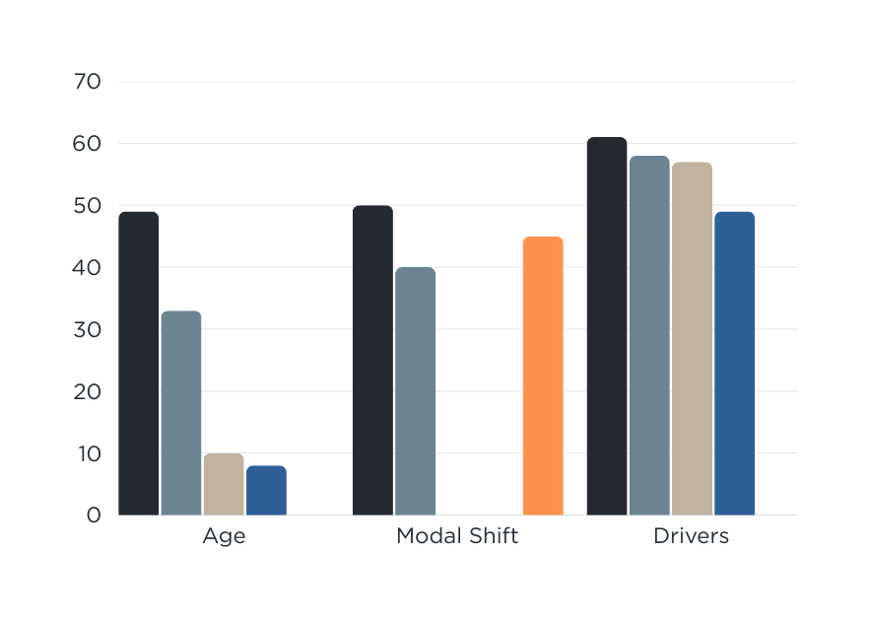
KEY DRIVERS FOR MICROMOBILITY ADOPTION
We ran a survey modeled after a CHATRLab study investigating the micromobility perceptions in Vancouver. Our survey ran from late November - early December and received 121 responses.
We found that 45% of the respondents who use private motor vehicles indicated that they would like to decrease their car usage.
The top motivating factors for e-mobility use were ease of travel & convenience, environmental benefits, reduced transportation costs, and increased physical activity.
Notes:
Survey Results from 121 respondents in Kamloops 49%(16-24), 33%(25-34), 10%(35-44), 8%(45-64).
When asked which modes of transport people used most often 44% were daily drivers and 31% used the transit daily. When asked about their ideal mode of transport, 50% of respondents indicated they would like to take up more active transportation with conventional bicycles and e-bikes being the most popular choices to achieve this. When it came to desired private car usage, 45% of respondents indicated they would like to decrease their usage. Another modality which people desired to increase their usage of was public transit, 40% of respondents.
We asked for the motivators of using e-mobility devices and the top 3 responses were Ease of travel & convenience (61%), Environmental benefits (58%), and Reduced transportation costs (57%). Another factor to note is using these devices for physical activity (49%) which is known to boost mental wellness as well as physical health.

Slide 7

BARRIERS AND CHALLENGES TO MICROMOBILITY ADOPTION
“This town has a vibrant community of cyclists...There needs to be much more investment and planning around pedestrian infrastructure...frankly dangerous at present... existing infrastructure is nonsensical and needs improvement ”
~Survey Respondent.

Slide 8
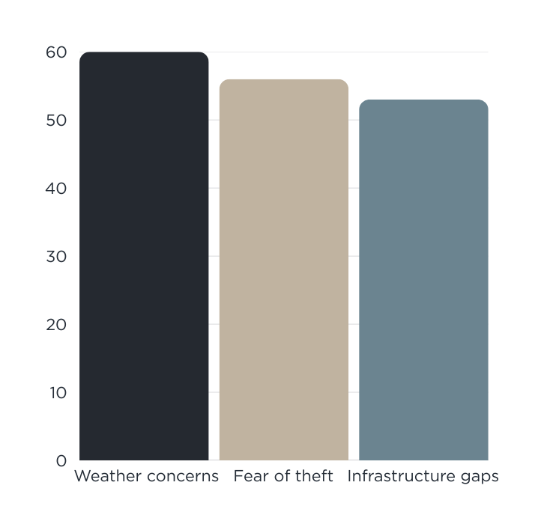
BARRIERS AND CHALLENGES TO MICROMOBILITY ADOPTION
KAMLOOPS FINDINGS
For micromobility as a whole, there are generally challenges faced with safety concerns, limitations in infrastructure, policy gaps, cost and equity issues, appearing at different degrees depending on the specific community.
Notes:
Within Kamloops, the issues identified were weather concerns (60%), fear of theft (56%), a lack of infrastructure to accommodate e-mobility (53%). Other concerns raised hindering use/acceptance included cost and cargo space, as well as a lack of familiarity with these devices.
It must also be noted that there are also challenges for the municipality adopting micromobility not only for the people who will ride them. It is important to have any micromobility program properly regulated, to ensure effective parking management and no disorderly riding.
Insights shared from the City of Kelowna’s Micromobility Manager highlighted the necessity to listen and address the public’s complaints/challenges. With new programs it can be expected to face mixed reactions. In Kelowna, many people had issues with the “dumping” of e-mobility devices wherever the trip ended, and in response to this, various changes were made including unit caps, parking zones and sidewalk detection. Being responsive in a timely manner to the concerns raised resulted in the city seeing significantly less complaints on the micromobility program.

Slide 9
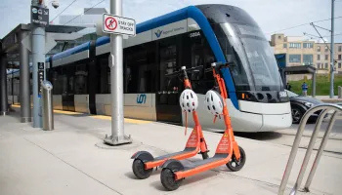
MICROMOBILITY & PUBLIC TRANSIT
  Micromobility supports the expansion of public transit systems by increasing individual access to transit stations, thereby extending the coverage area of each station.
  75% of the respondents in Kamloops believe that it can solve the first- and last mile problem and connect people to public transit, and 70% believe that it should be integrated with public transit.
Notes:
An innovative approach to integration implemented in Calgary. The city conducted a pilot project at three LRT stations with limited local bus connections. The city provided a subsidy to private micromobility operators to ensure vehicle availability and to offer free trips within a 15-minute range of these stations. Follow-up surveys with users showed a 100% satisfaction rate, and respondents reported that this initiative led them to use transit more often.

Slide 10
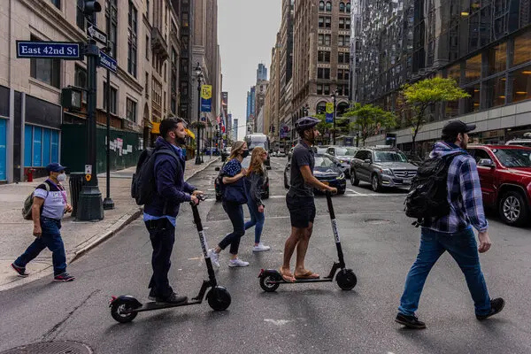
MICROMOBILITY & PUBLIC TRANSIT
“I worry about pedestrian safety, without designated spaces on roads for micro mobility ...they often take up pedestrian areas... More enforcement of road rules, I notice a lot of bikes tend to not follow road rules as strictly... I worry other micro mobility options will act like this as well.”
~Survey Respondent.
Notes:
When the Finch West LRT and Eglinton Crosstown stations were being designed 10 years prior, space was not protected for bike share infrastructure. This was because, at the time, planners did not anticipate the presence of bike share in those areas. Consequently, Bike Share Toronto has had to retroactively find locations as close as possible to these stations. This is an illustration of a lack of initial integration planning between micromobility and public transit infrastructure in a major Canadian city.

Slide 11
MICROMOBILITY & SMART CITIES
  The idea of smart cities revolves around digitally empowered, interconnected systems that work together to improve the daily lives of the community.
  Data generated by micromobility services can feed decision-making processes and help inform cities, ultimately leading to more data-ready and smarter decisions.
  By analyzing trip patterns, usage frequency in different areas, and other metrics, cities can gain insights into transportation demands, the impact of micromobility on congestion, and the effectiveness of current infrastructure.
Notes:
The data generated by micromobility services can be a valuable resource for urban planners and policymakers. According to Alta, this data can feed decision-making processes and help inform cities, ultimately leading to more data-ready and smarter decisions. By analyzing trip patterns, usage frequency in different areas, and other metrics, cities can gain insights into transportation demands, the impact of micromobility on congestion, and the effectiveness of current infrastructure. This information can then be used to guide future planning efforts, such as the placement of bike lanes or the integration of micromobility with public transit.
The application of IoT in micromobility is an interesting area with significant potential. The infrastructure associated with micromobility, particularly docked stations, could be leveraged to incorporate other smart city technologies. New York City repurposing phone booths to offer free Wi-Fi, highlights how existing urban infrastructure can be adapted to provide additional public benefits. Similarly, micromobility stations could potentially host sensors for environmental monitoring, act as charging hubs for other electric vehicles, or provide real-time information to citizens, contributing to the development of smarter urban environments.

Slide 12
TOWARDS UNITED NATIONS SUSTAINABLE DEVELOPMENT GOALS
SDG 3: Good Health and Well-being
SDG 11: Sustainable Cities and Communities
SDG 13: Climate Action
Micromobility can contribute to this goal by lowering toxic gas emissions and reducing projected traffic accidents. Furthermore, studies indicate that there are physical and mental health benefits associated with using micromobility.
Micromobility plays a major role in achieving this SDG by increasing transportation accessibility, reducing traffic congestion, and improving air quality. It can contribute to making cities more safe, resilient, and sustainable.
A significant contribution of micromobility lies in reducing greenhouse gas (GHG) emissions and lowering carbon emissions. By motivating people to leave their cars at home and opt for micromobility or common transport, toxic emissions from the automotive sector can be eliminated.

Slide 13
RECOMMENDATIONS
  Adopt Flexible and Adaptive Policymaking - Municipalities should recognize that the micromobility landscape is rapidly evolving and be prepared to adapt their regulations based on evolving needs and public feedback, as demonstrated by Kelowna's experience.
  Consider Different Municipal Approaches to Program Management - Municipalities have various options for managing shared micromobility programs. There are choices between more public-focused or public-led approaches, as seen in cities like Montreal and Toronto, versus private-led programs with varying levels of municipal oversight.
  Invest in and Prioritize Bike Infrastructure for Safer Use - Investing in protected bike lanes and other cycling infrastructure significantly enhances safety. The Kamloops survey respondents also highlighted the benefit of various traffic control devices for promoting micromobility and active transportation, including high visibility crosswalks, bicycle traffic signals, improved signage and wayfinding, and shared-use paths.
  Focus on Building Public Confidence Through Safety and Communication - The Kamloops survey indicated that providing safety guidelines and best practices for riding e-bikes and e-scooters is crucial for building public confidence.

Slide 14
Thank You
Any Questions?

