Slide 1

Brand Audit
Fuel Supplements Kamloops
Team 6:
Gopi Yerraguntla
Eva Lawrence
Rufaro Mundangepfupfu
Anton

Slide 2
Executive Summary
This brand audit analyzes Fuel Supplements Kamloops' current brand position, identifying key strengths, weaknesses, opportunities, and threats.
Our findings suggests that while Fuel enjoys strong customer relationships and a reputation for quality service, it lags in marketing strategy, brand awareness, and online presence.
Recommendations to improve Fuel's brand equity include:
  Developing a clear brand message and strategy.
  Enhancing the online presence, including website functionality and social media engagement.
  Leveraging the unique selling proposition of Limitless Protein.
  Implementing a structured marketing plan with measurable goals.
  Improving in-store signage and visual branding.

Slide 3
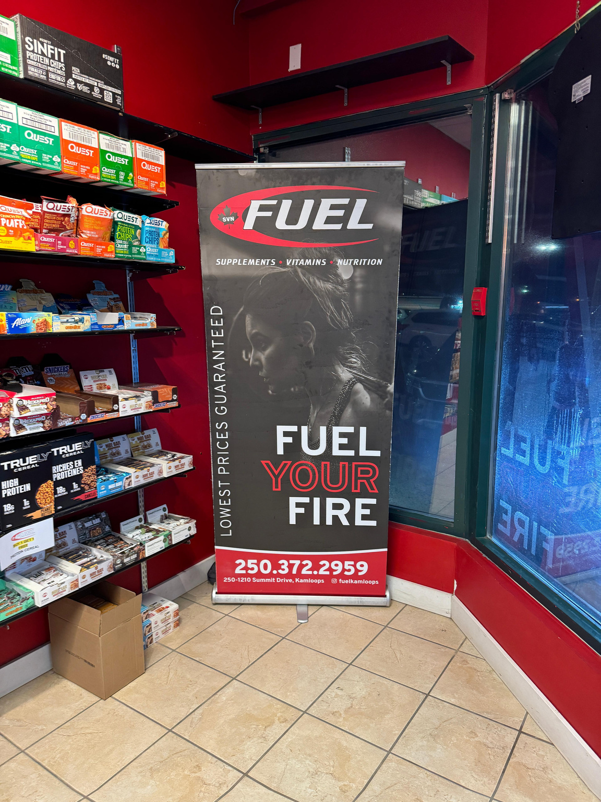
Brand Audit:
Goal & Objectives
Goal 1: Conduct a comprehensive brand audit to assess Fuel Supplement's current brand equity and identify areas for improvement.
Goal 2: Develop a strategic marketing plan with actionable recommendations to enhance brand awareness, customer loyalty, and profitability.
Goal 3: Provide Fuel Supplements with a roadmap ‘for sustainable business growth and market leadership in the Kamloops area.

Slide 4

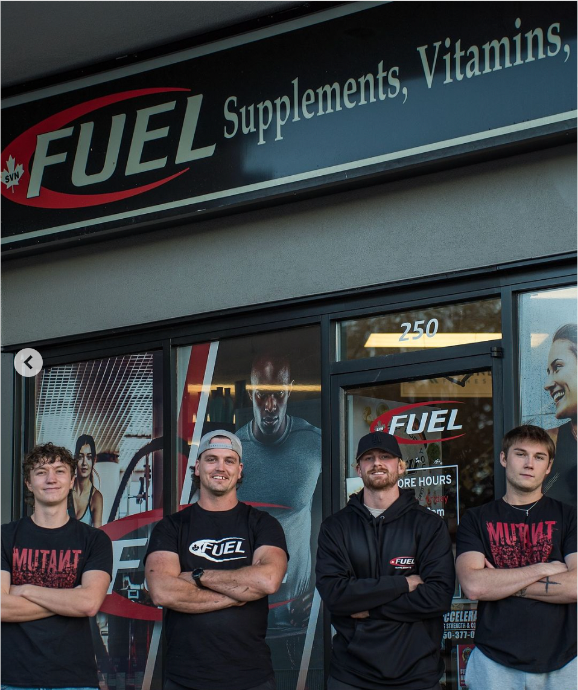


Company Overview
  Fuel Supplements is a franchise operating in Kamloops.
  While benefiting from franchise buying power, Fuel Kamloops operates independently for marketing, sales, and purchasing decisions.
  The owner actively participates in daily operations and customer interactions.
  The company has a strong focus on customer relationships, product quality, and customer education.
Zavora
R

Slide 5
Company Overview
Mission & Values
  Mission:
  To empower individuals to achieve their health and fitness goals by providing high-quality supplements and expert advice.
  Values:
  Customer well-being, product quality, education, and community engagement.
Zavora
R

Slide 6
Company Overview
Products & Services
  Wide selection of supplements catering to various fitness needs and disciplines, including bodybuilding, general health, and fitness.
  Exclusive offering of Limitless Protein, a key differentiator and top-selling product.
  Emphasis on high-quality products with clean ingredients, prioritizing customer well-being.
  Knowledgeable staff who provide personalized recommendations and experiential advice on supplement selection and usage.
  Additional services include two tanning station in the physical store.
Zavora
R

Slide 7
Brand audit findings
High dependency on sponsored ads
Owners network
Impression Marketing
customer-oriented supplement store
Limitless protein powder
Strong colors

Slide 8
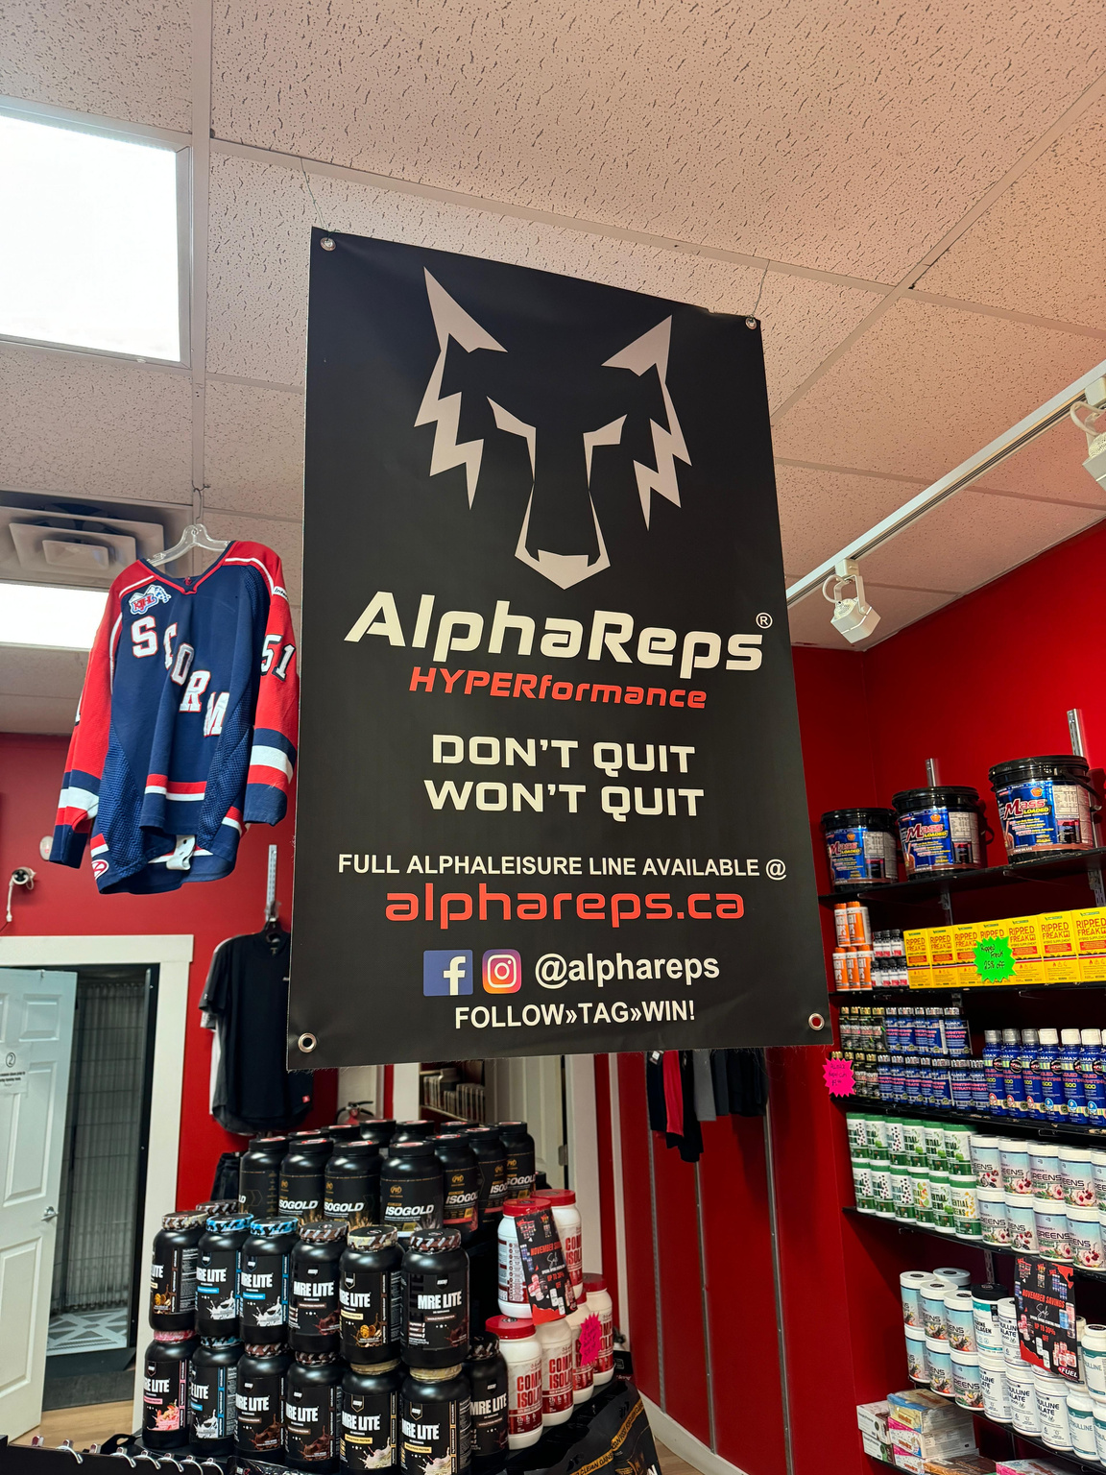
Impression Marketing

Slide 9
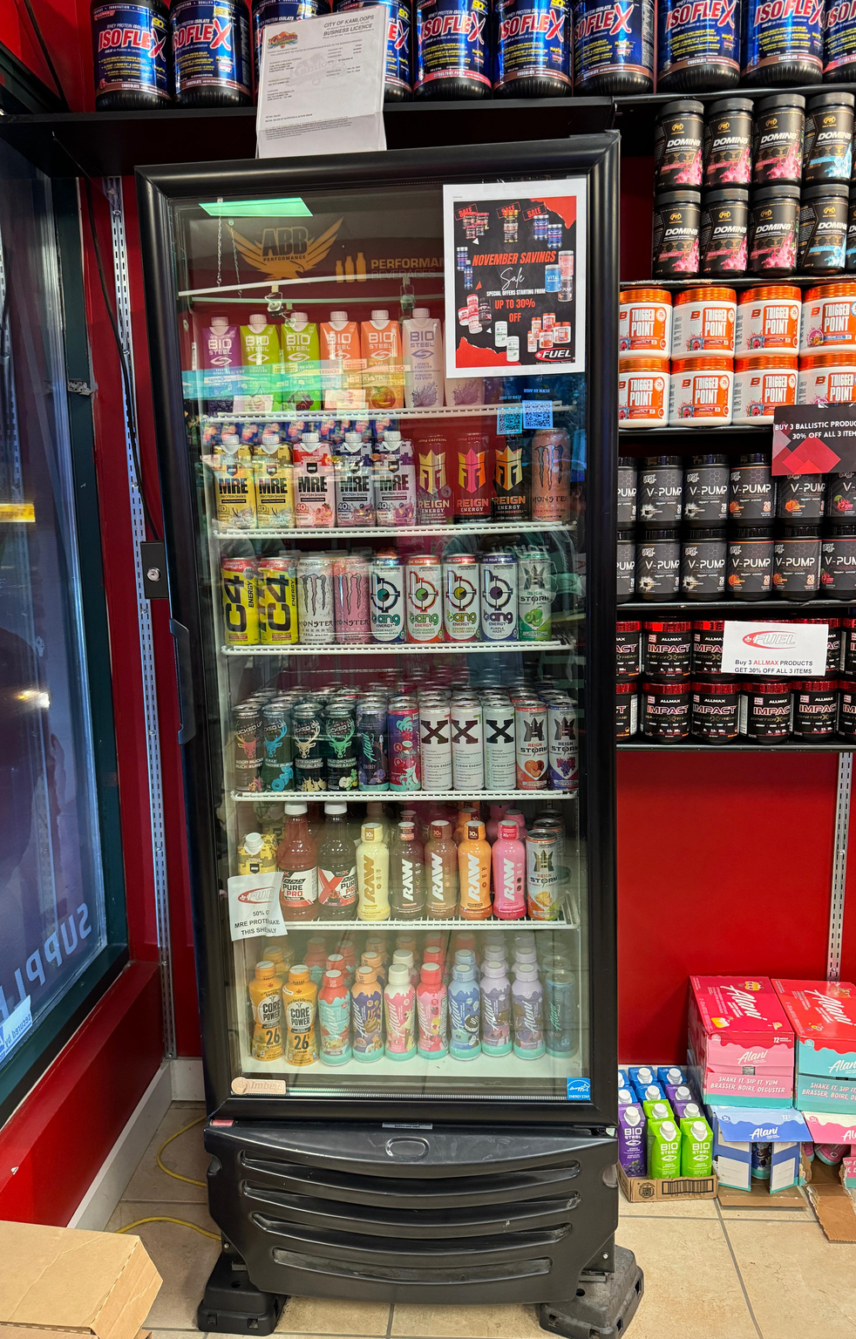
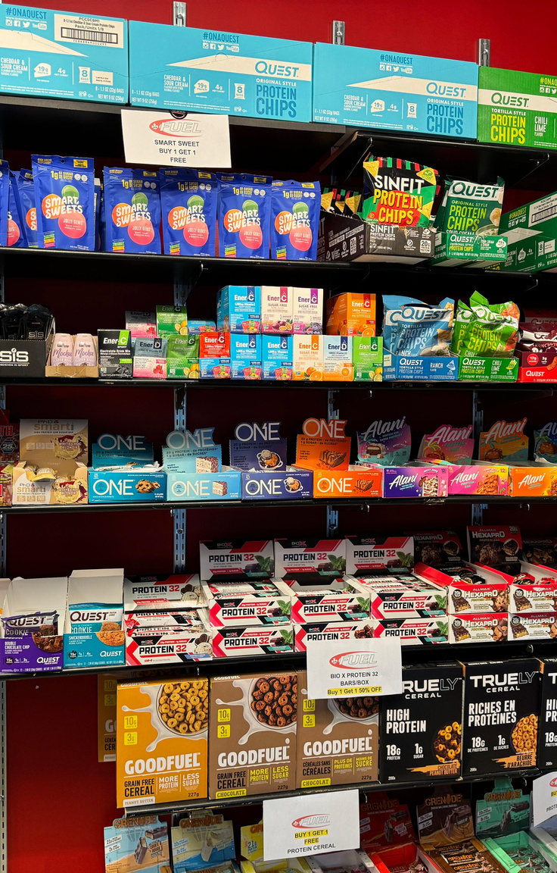
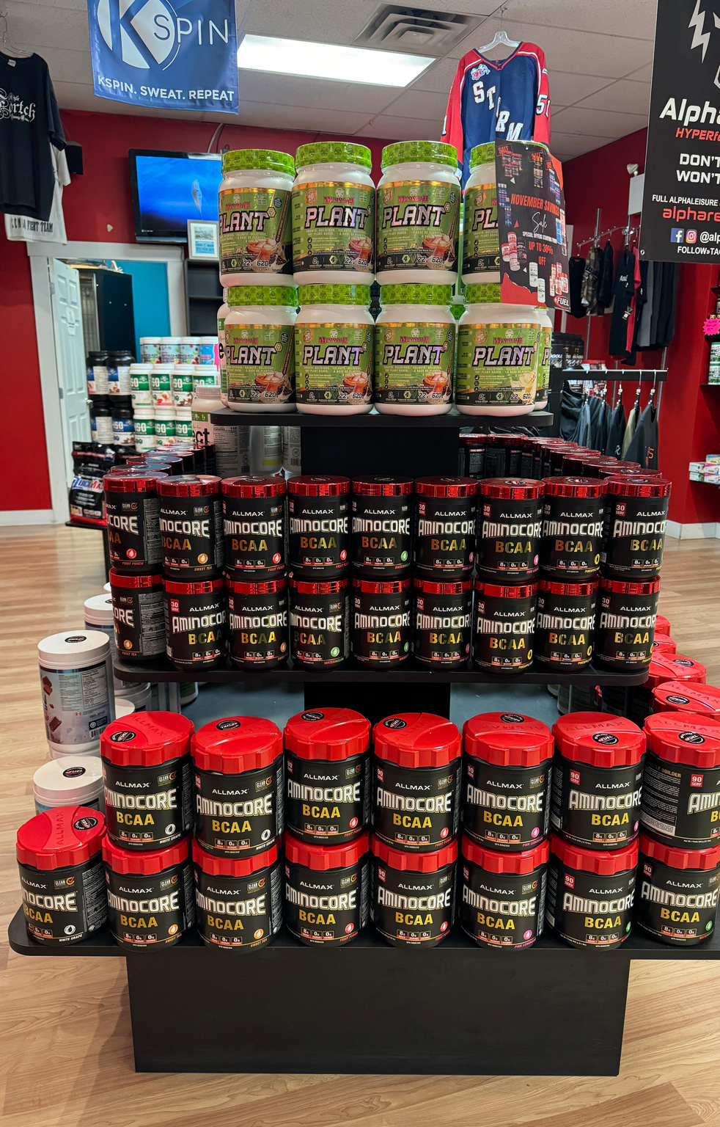
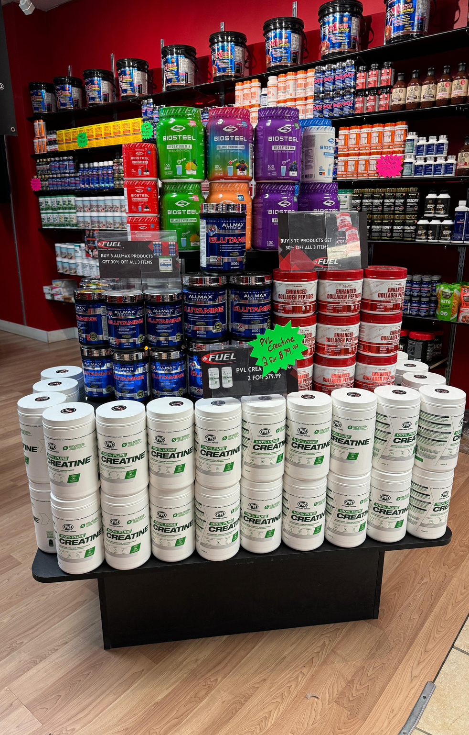
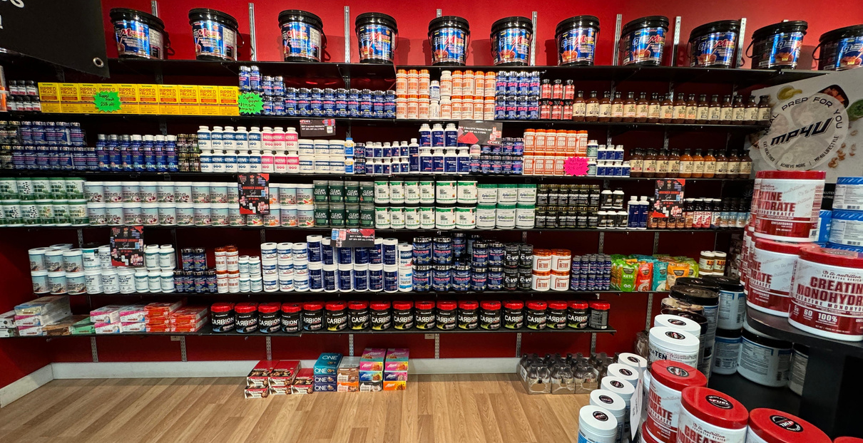
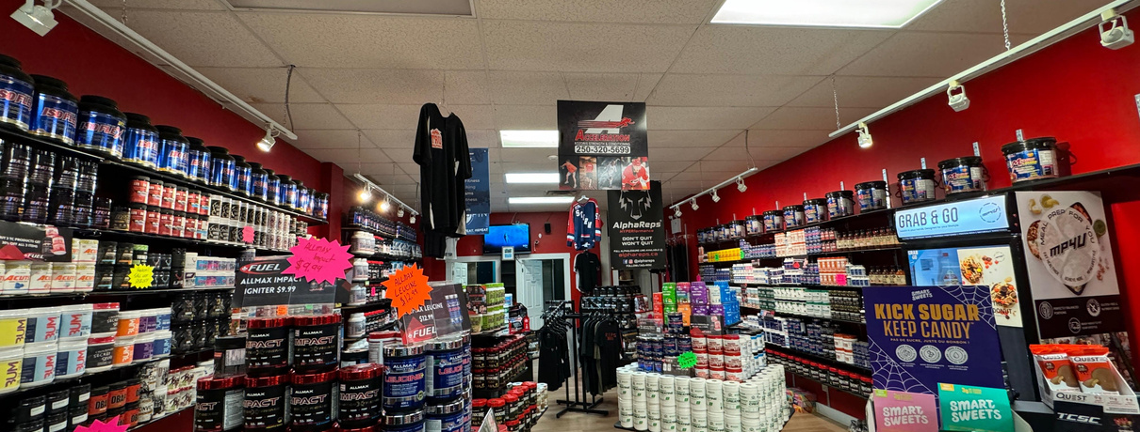
Planogram - well implemented

Slide 10
Growing & Sustaining Brand Equity
Expanding online presence
Loyality program
Limitless product promotions; highlighting clean ingredients
Sell on Instagram
Staff incentives for social media participation
Engage in local events

Slide 11

Brand Audit Current Strategy
Brand Positioning
  Unique Value Proposition: Fuel Kamloops positions itself as an inclusive supplement provider that serves athletes of all fitness levels and sports, from garage trainers to professional competitors.
  Community-Centric Identity: By partnering with local gyms, the brand fosters a strong sense of belonging and trust within the Kamloops fitness community.
Marketing and Communication Strategies
  Community Engagement: Emphasizing partnerships with gyms and providing tailored advice reinforces their reputation as a trusted local expert.
  Customer-Centric Messaging: The focus on inclusivity ("all shapes, sizes, and sports") appeals to a broad demographic, breaking stereotypes about supplement users.
  Word-of-Mouth Advocacy: Leveraging satisfied customers and local athletes to promote the brand's authenticity and effectiveness.

Slide 12
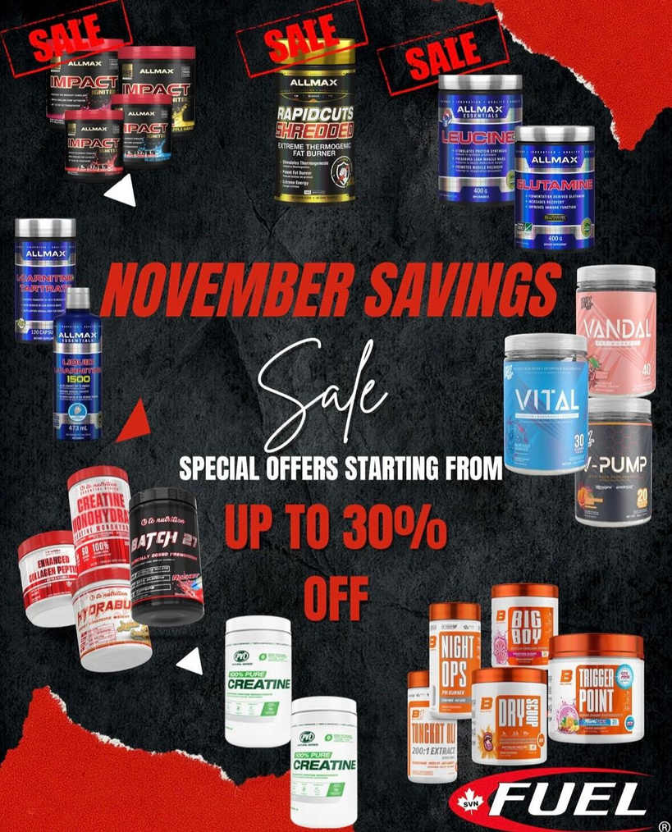
Brand Audit Current Strategy
Customer-Oriented Approach: The owner emphasizes the importance of customer service and providing value to customers. Their product selection prioritizes quality and customer needs over simply stocking hot-selling items. This customer-centric approach fosters repeat business and positive brand associations.
Competitive Pricing Strategy: While the shop initially prices products at MSRP, they offer various discounts and combos, making their final prices competitive with major players like Popeye's. They aim to avoid price wars by focusing on value and bundle deals.

Slide 13
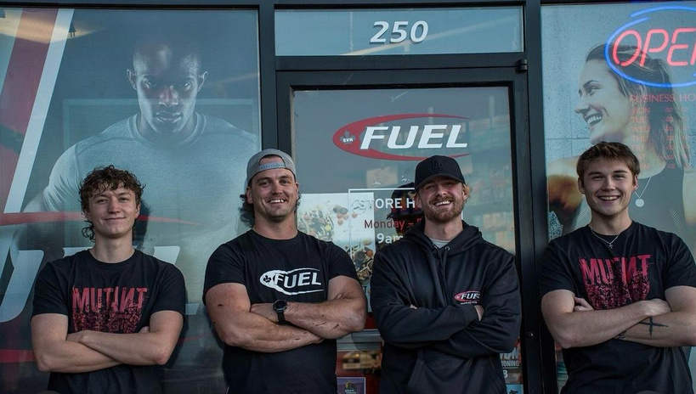
The View from the Inside Out (Internal)
Customer Orientation as an Internal Strategy: The company focuses on creating outstanding customer experiences by empowering staff to exceed expectations and build strong, lasting relationships. Internal initiatives emphasize employee training in product knowledge and customer service, ensuring personalized, expert guidance that consistently earns positive customer feedback.
Staff Values as an Internal Strategy:The company cultivates a team culture where employees take pride in their roles, excel in product knowledge, and focus on helping customers achieve their goals. This commitment to education and personalized guidance sets the company apart from competitors that prioritize sales over customer-centric service.

Slide 14
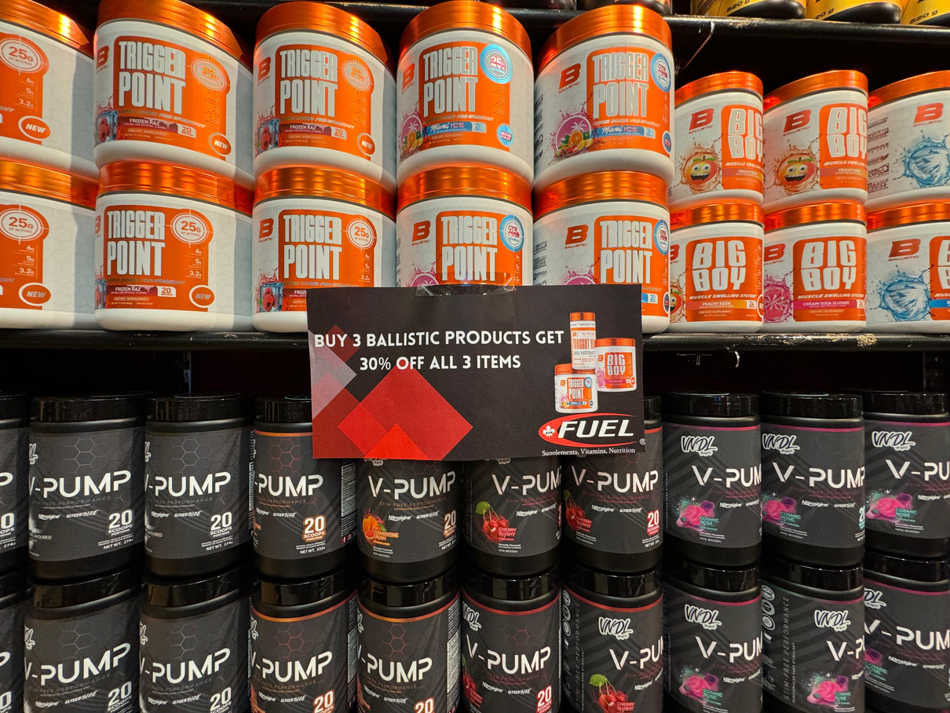
The View from the Inside Out (Internal)
Products and Services: Quality over Trend
The shop's product selection strategy prioritises quality and customer benefit over merely stocking trending items. This approach reflects the owner's commitment to customer well-being and a desire to educate customers about healthy choices.
Ingredient Scrutiny: The company avoids products containing potentially harmful ingredients like dyes and seed oils, even if those products are popular elsewhere. This demonstrates a commitment to product integrity and customer health.
Staff Expertise: The staff actively stays informed about the latest research and industry developments through podcasts and social media, enabling them to educate customers on product benefits and potential risks. This further reinforces the shop's positioning as a source of reliable information and guidance.
Capitalising on Gaps: The shop actively seeks to offer products not readily available from local competitors, such as the "Limitless" protein product, ensuring a unique selling proposition

Slide 15
SWOT ANALYSIS
A) Strengths:
Low Operating Costs: No royalty payments, more flexibility with pricing.
Customer Trust: Positive reputation and helpful staff, especially for women.
Diverse Products: Appeals to bodybuilders and general health customers.
Established Brand: Over 20 years in business.
Local Partnerships: Strong relationships with gyms to attract customers.
Social Media: Active on Instagram & Facebook with paid ads.
B)Weaknesses:
Traditional Marketing: Relies heavily on flyers and posters.
Weak Online Presence: Website is underdeveloped, no strong e-commerce.
Staff Engagement: Difficulty getting staff to create content for social media.
Limited Promotions: Low customer engagement with discounts.
c)Opportunities:
E-Commerce Growth: Develop a stronger online sales platform.
Loyalty Programs: Implement customer rewards to increase retention.
Influencer Marketing: Partner with local influencers for better visibility.
Branding with Merchandise: Expand branded merchandise (e.g., shaker cups).
Gym Sampling: Continue in-gym product demonstrations.
D)Threats:
Big Competitors: Larger chains like Popeye’s and online stores.
Price Sensitivity: Customers may choose cheaper alternatives elsewhere.
Economic Conditions: Potential decline in traffic and sales.

Slide 16
Situation Analysis
A)Market: The supplement industry is competitive with large players and online shopping growing fast.
B)Target Market: Bodybuilders, fitness enthusiasts, and health-conscious individuals.
C)Current Strategy: Focus on in-person marketing (gym demos, flyers) and social media ads.
Key Issues:
Marketing could be more digital-focused.
Need to improve online sales and website.
Increase customer engagement with promotions.

Slide 17
Conclusion
  Fuel Supplements Kamloops possesses the fundamental elements for success, including a strong customer service culture, a competitive pricing strategy, and a passionate owner.
  Exclusive offering of Limitless Protein, a key differentiator and top-selling product.
  The dynamic nature of the supplement industry requires ongoing adaptation and innovation.

Slide 18
References
Keller, K. L. (2020). Strategic brand management: Building, measuring, and managing brand equity (5th ed.). Pearson Education.
Fuel Kamloops. (n.d.). Retrieved November 18, 2024, from https://fuelkamloops.ca/
Fuel Supplements Kamloops [@fuelkamloops]. (n.d.). Instagram. Retrieved November 18, 2024, from https://www.instagram.com/fuelkamloops/
Thank You

