Slide 1
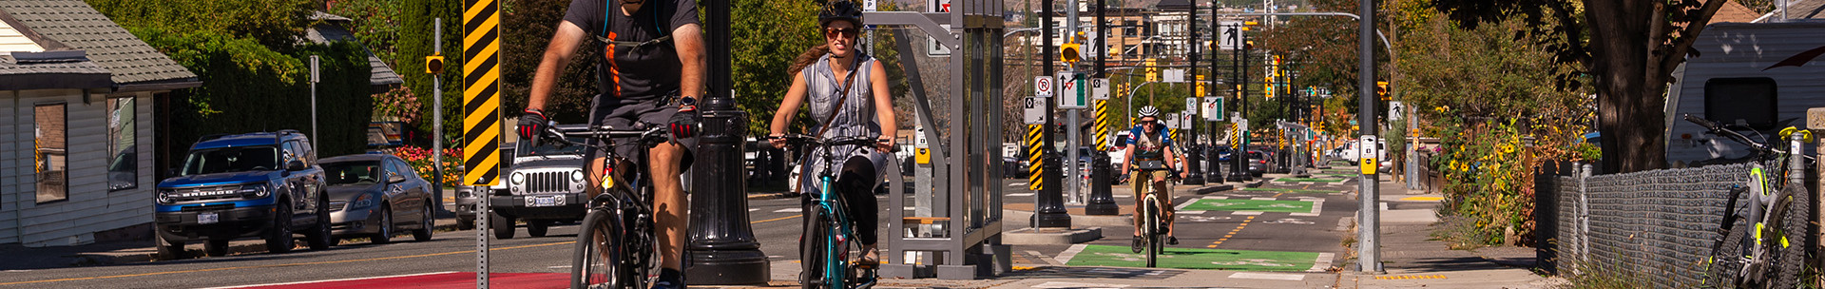
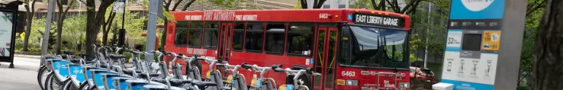
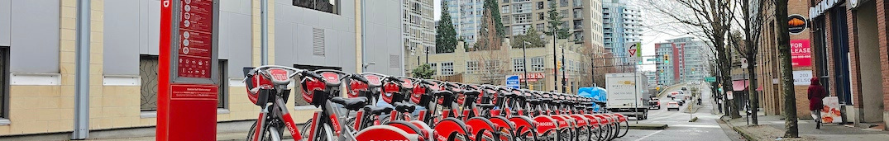

SHAPING TOMORROW’S CITIES: THE SUSTAINABLE POTENTIAL OF MICROMOBILITY
PI: Rufaro Mundangepfupfu
Supervisor: Dr. Zubair Raja
Thompson Rivers University

Slide 2

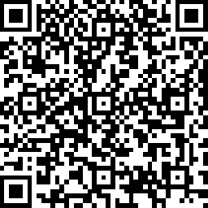
Thank You
Questions?
Share Your Thoughts on Micromobility

